Slide 1

CLIMATE COMMISSION FOR THE SAHEL REGION
SAHEL RESILIENCE
4×5
INITIATIVE
4 integrated flagship projects over 5 years
A commitment pact for resilient, stable and prosperous development in the Sahel
USD 1.05 BILLION
Addis Ababa, 29 April 2026

Slide 2
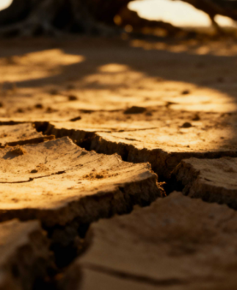
A region facing
multiple challenges
THE SAHEL
Climate challenges
Recurring droughts and extreme rainfall are undermining Sahelian ecosystems.
Regional instability
Conflicts linked to the scarcity of natural resources within local communities and socio-political tensions
Diverse interventions
Responses that are too fragmented to address the resilience of populations at the end of their tether.

Slide 3
CLIMATE-RELATED ECONOMIC RISK
Inaction threatens a quarter
of the Sahel’s wealth
Due to climate change, African countries are losing 2 to 5% of their GDP every year.
The Sahel, which is highly vulnerable, is at the upper end of the scale.
If this trend continues…
5%
25%
Annual loss of GDP
5-year contraction
Social risk
Recurring climate shocks
¼ of the Sahel’s wealth
Migration tensions

Slide 4

The 4×5 Initiative: a
coherent and integrated
PAJEP-2R
PRESCOE
Empowering young people through resilient rice farming in the Sahel. Budget: USD 200 million
Restoration of the ecological corridor to preserve biodiversity and natural resources. Budget: USD 200 million
PEPACE
PR2U-Sahel
Development of clean energy infrastructure to increase access to electricity in rural areas of the Sahel. Budget: USD 250 million
Strengthening urban resilience to climate and social shocks. Budget: USD 400 million
TOTAL: USD 1.05 billion

Slide 5
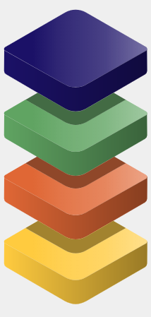
Interdependent architecture
Interdependent projects to ensure stability and growth
The failure of a single project leads to the failure of the others
Agricultural employment
PAJEP-2R creates 40,000 green businesses. The food foundation of resilience.
Land restoration
PRESCOE restores 10,000 ha and reduces conflicts by 50%. Fertile soil, social peace.
Clean energy
PEPACE connects 1 million people in the Sahel to the electricity grid. Support for services and productivity.
Urban resilience
PR2U protects 5 million people from flooding.

Slide 6
Green agricultural enterprises
40,000 businesses created for young people
Income increased by 3.5 times (US$1 → US$3.50 per day)
Strengthening the foundations of resilience:
Youth employment and land restoration
System of Rice Intensification (SRI)
45% reduction in methane emissions
Enhanced productivity and sustainability
Land restoration
10,000 hectares restored
50% reduction in resource-related conflicts
600,000 direct beneficiaries
USD 400 million

Slide 7



1 million households
Reduction in losses
Build
resilience:
energy & cities
Connection via 400 MW of operational solar capacity
30% reduction in economic losses in urban centres
Urban protection
5 million city dwellers protected from flooding
$650 million

Slide 8

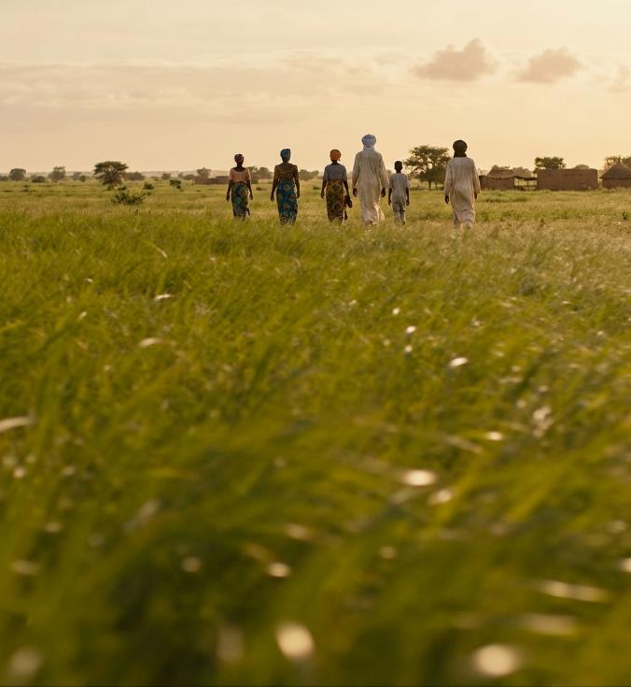
5-year impact
Tangible results redefining the trajectory of
the Sahel’s development by 2031.
7.6M
12.1M
Direct beneficiaries
tCO2 avoided per year
125,000
156M USD
Direct jobs created
Additional revenue / year

Slide 9
Investing 0.2% of GDP to
avoid a 25% loss
Indicator
Status Quo (Inaction)
4×5 Initiative (Pact)
Annual economic cost
Loss of 5% of GDP
Investment 0.2% of GDP
Impact on regional wealth
−25% over 5 years
+$156 million per year
Social stability
Resource conflicts
50% reduction in conflicts
Climate resilience
Increased vulnerability
12.1M tonnes of CO2 avoided per year

Slide 10
IMPLEMENTATION PLAN
Planning
Launch
5-year implementation
Continued consultation with stakeholders
Development of the four projects
Organisation of a regional launch event and mobilisation of resources for the 4×5 Initiative
Full implementation cycle
Performance reviews
Q1 2027
2027–2032

Slide 11
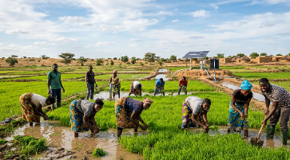
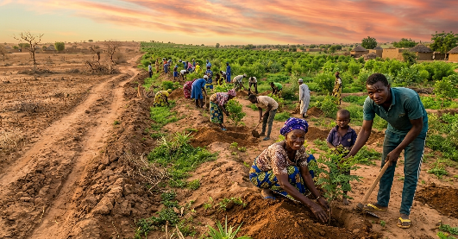
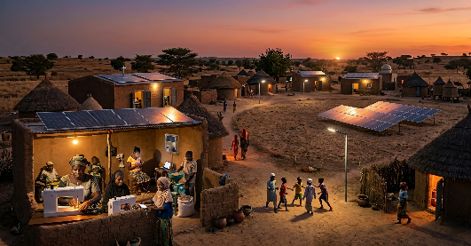
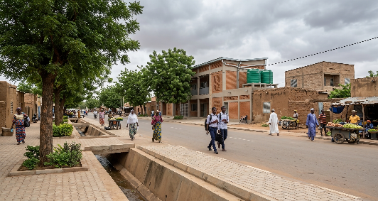
Mobilising
funding
to transform
the Sahel
PAJEP-2R - Sahel
PRESCOE - Sahel
USD 1.05 billion
PEPACE - Sahel
To be mobilised
4 projects
Structural & integrated
5 years
Full implementation cycle
7.6 million lives
PR2U-Sahel
Lives transformed by 2031
The CCRS stands ready and committed to supporting any form of collaboration in favour of this bold initiative for the benefit of Sahelian communities

Slide 12



THANK YOU FOR YOUR ATTENTION

